Slide 1
QUADCOPTER
PRESENTATION
Author: Tilen Mavri
Erasmus+ project Airnet

Slide 2
SUMMARY
Our intention was to create a flying quadcopter
Basic equipment
Computer-plate (DJI Naza)
On Nazo it is connected to the GPS

Slide 3
PROJECT IDEA
Both of us are interested in electrical engineering
At first we wanted to creat a radio-guided aircraft
Quadcopter – a bigger challenge

Slide 4
FACTS
This quadcopter which will be made, will be used for measuring of different harmful gases and for taking some good pictures from the air.

Slide 5
MECHANICS
the frame, propellers and the electric motors
carbon fiber composites have become a very common solution for the body of the copters
The electrical components: electronic speed control module, on-board computer or controller board, and battery.

Slide 6
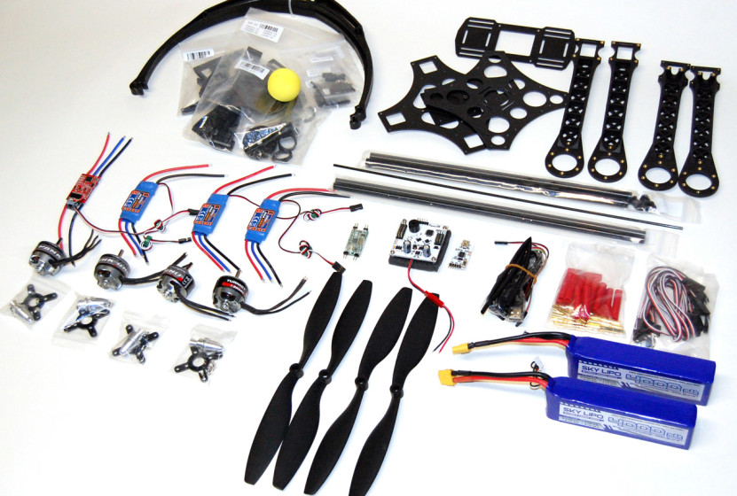

Slide 7
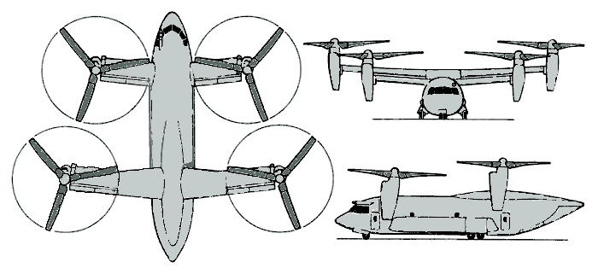
TYPES
The Bell Boeing Quad TiltRotor concept

Slide 8
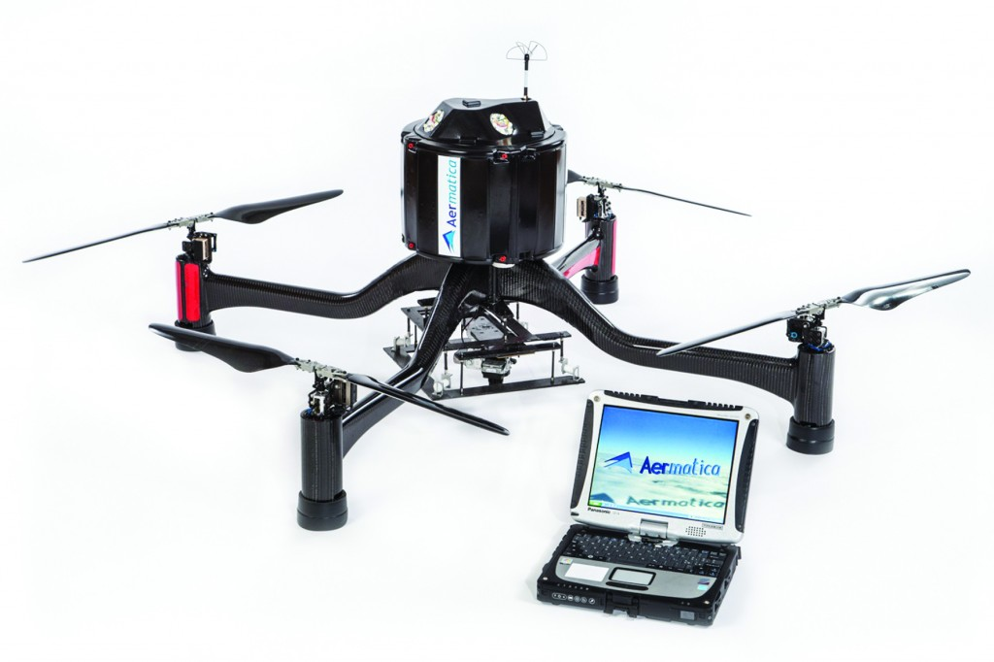
Parrot AR.Drone 2.0 take-off

Slide 9
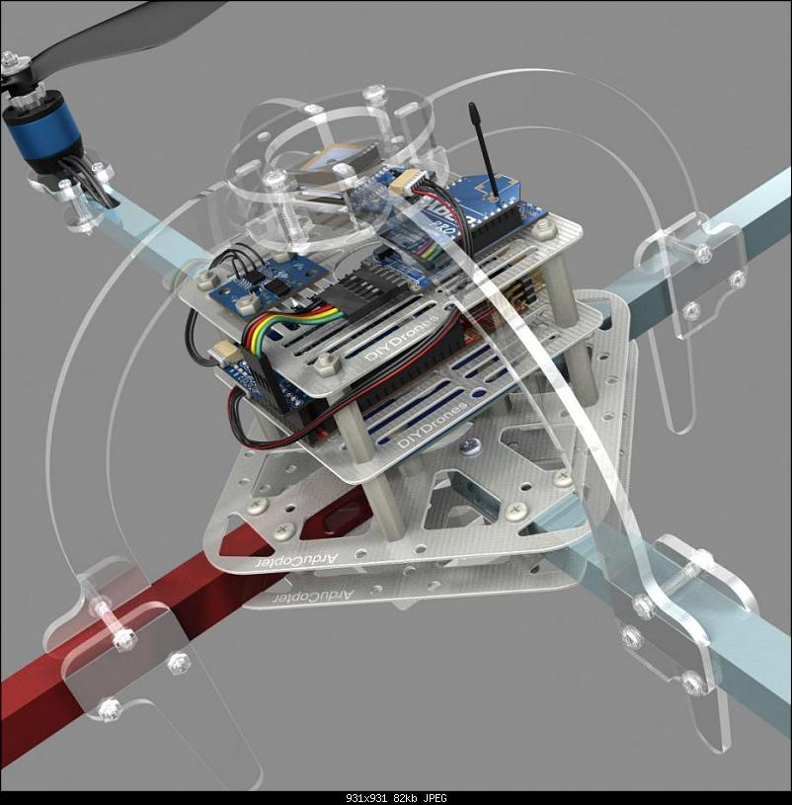
AerioQuad and ArduCopter are open-source

Slide 10
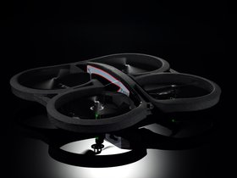
Parrot AR.Drone is a small radio contolled quadcopter

Slide 11
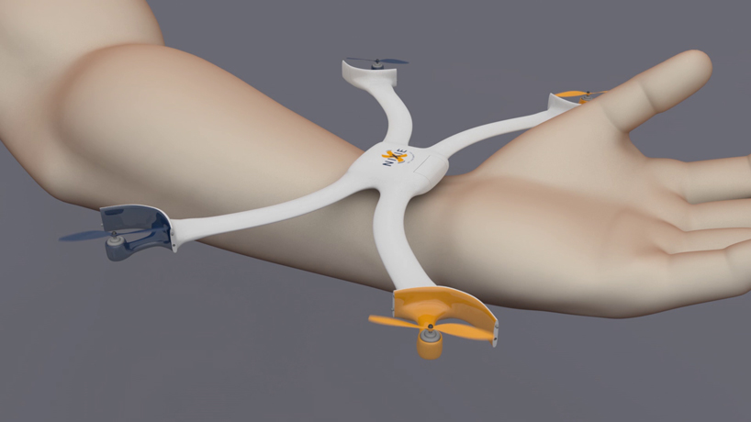
Nixie is a small camera-equipped drone that can be worn as a wrist band

Slide 12
VORTEX RING STATE
subject to normal rotorcraft aerodynamics
Forward flight
Upflow
Descent
The failure of a helicopter pilot to recognize and react to the condition can lead to high descent rates and impact with terrain.

Slide 13
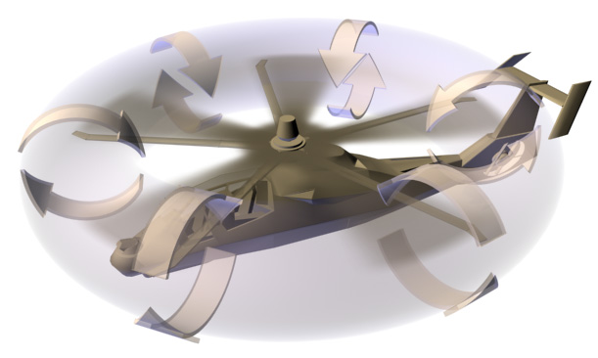
https://www.youtube.com/watch?v=-UUv9VUG4Jc&authuser=0

Slide 14
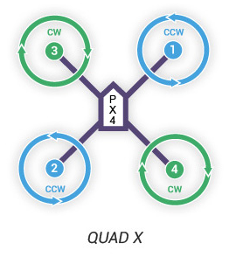
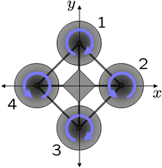
FLYING
a thrust and torque
a drag force

Slide 15
THANK YOU FOR YOUR ATTENTION!

