Slide 1
CASCADE IMPACTOR
By: Žiga Markovič and Tilen Mavri
Mentors: Nejc Grošelj, Jurij Drev, Tanja Pirih
Jurij Vege grammar school Idrija

Slide 2
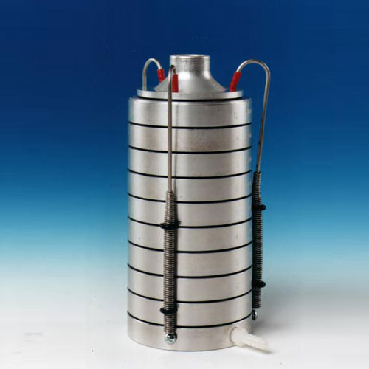
What is cascade impactor
Multistage collectors
Works on falling and velocity

Slide 3
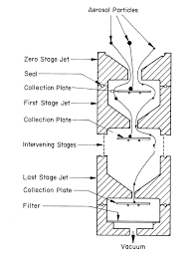
How it works
Assembled in rows
Smaller jets every sta
Collection plate

Slide 4
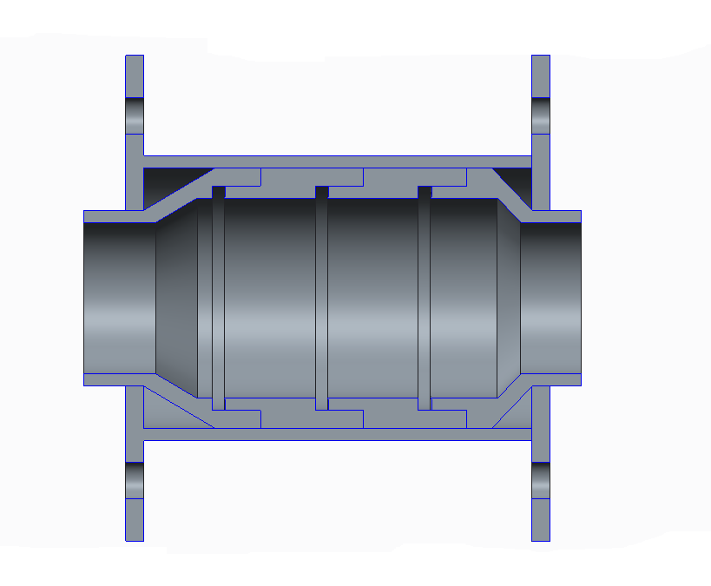
project
it´s finnished
Just need testing

Slide 5
Thank you for your attention
more information about Airnet project: http://www.airnet-erasmus.eu/

